Slide 1













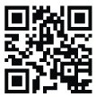








ETIP (Electricity Tariff Incentive Program)
(Existing Companies)
Version 3.0
Presented by: Zayed Chartered Accountant
For Auditing
www.zcaa.ae

Slide 2





About Us
Zayed Chartered Accountant for Auditing is a fast-growing professional firm in the fields of audit & assurance and other financial advisory services in United Arab Emirates.
Salient Features are:
Certifying body of ICV (In-country value Added)
Member of ABACUS worldwide and TASK international Audit Specialists
Network all over the world
Authorized for Issuing of Reports for Rule of Origin (Kingdom of Saudi Arabia)
Expert team for Internal & External Audit and for Advisory assignments
VAT and Bookkeeping expert
Liquidation Experts

Slide 3










Our Affiliations
Affiliation in Progress

Slide 4

Introduction- ETIP (Electricity Tariff Incentive Program)
The Electric Tariff Incentive Program aims to promote competitiveness and investments in Abu Dhabi as a first option for industrial companies having high-level of automation, productivity and economic impact through boosting the productivity level of industrial facilities, enhancing their economic impact and improving energy efficiency.

Slide 5


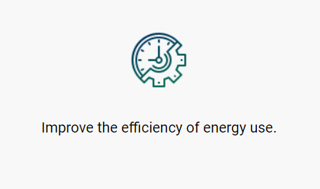
Objectives of ETIP

Slide 6


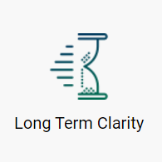

Values of ETIP

Slide 7


Stakeholders Roles and Responsibilities
There are four key stakeholders in the Electricity Tariff Incentive Program.
1- Industrial Development Bureau – IDB
Industrial Development Bureau-IDB is under the Department of Economic Development.
Overall monitoring program implementation process.
Decide on the appropriate category for the applicant based on T&Cs agreement.
Issue enrollment certificates to the qualified applicants.

Slide 8


2- Distribution Company- DC
Abu Dhabi Distribution Co. and Al Ain Distribution Company
Awareness workshops about energy demand management.
Prepare Consumption and Data Performance History.
Issue Consumption Certificates.
Implementation of new electricity tariff.

Slide 9

3- Certifying Bodies - CBs
Prepare certifying quotation for manufacturing entities.
Measure economic impact, productivity of manufacturing entities using program evaluation criteria.
Issues ETIP evaluation balance score card, reports and renews annually.

Slide 10

4- Manufacturing entity
Prepares financial information to CB to allow evaluation of all parameters of the Electricity Tariff Incentive Program.

Slide 11
In ETIP- Criteria of Existing Companies and New Companies
Existing Companies
The industrial entities which are in operation/production for more than 6 months from date of issue of the production/operational license from ADDED are eligible as Existing companies.
New Companies
The industrial Entities which have “under construction” license issued by ADDED and/or companies which are in operation for first 6 months from the date of issue of “production/operational” license issued by ADDED

Slide 12
Electricity Tariff Incentives Program

Slide 13
Categories of distribution connected entities
Category A
(Score > 80 Points) 20 Fils
Category B
(Score Between 80-60 Points) 22 Fils
Category C
(Score Between 59-50 Points) 25 Fils
*** If the manufacturing entity scored less than 50 points, the actual tariff prices will be charged accordingly.

Slide 14


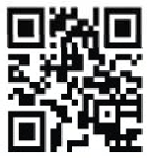
Abu Dhabi
Mezzanine Office M 01 Atlas Telecom, Al Nahyan Camp Tel.:+97126666828 - Email: info@zcaa.ae
P.O.Box 41145 , Abu Dhabi, UAE
DUBAI
29th Floor, Office 2903, The Prism Tower, Business Bay Tel.:+97143960006 - Email info@zcaa.ae
zayedcharted
zayed_chartered_acc

